Slide 1
Regression Analysis
Multiple Linear Regression
Nicoleta Serban, Ph.D.
Professor
School of Industrial and Systems Engineering
Inference for Regression Parameters

Slide 2

About This Lesson

Slide 3
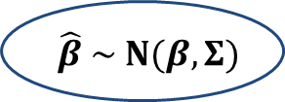
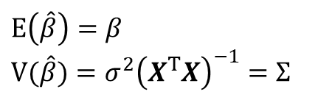
Sampling Distribution
$$E\left(\hat{β}\right)=β$$
$$V(\hat{β})=σ^{2}{\left(X^{T}X\right)}^{−1}=Σ$$
Furthermore, $\hat{β}$ is a linear combination of {y₁,…,y_{n}}. If we assume that ε_{i} ~ Normal (0, σ²), then $\hat{β}$ is also distributed as
$$\hat{β} \sim N(β,Σ)$$

Slide 4

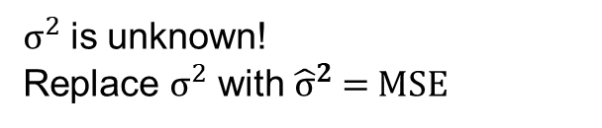
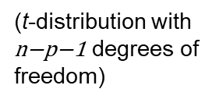
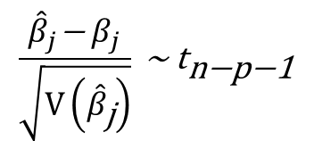
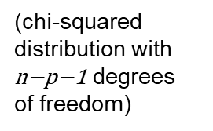
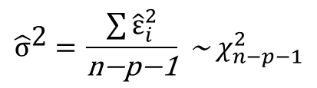
Properties of Regression Estimators
$$\hat{β} \sim N(β,Σ)$$
$σ^{2}$ is unknown!
Replace $σ^{2}$ with ${\hat{σ}}^{2}$ = MSE
$${\hat{\text{σ}}}^{\text{2 }}\text{=} \frac{\sum{{\hat{ε}}_{i}^{2}}}{\text{n}\text{−}\text{p}\text{−1}}\text{ \sim } χ_{n−p−1}^{2}$$
$$\frac{{\hat{β}}_{j}\text{−}{ β}_{j}}{\sqrt{\text{V}\left({\hat{β}}_{\text{j}}\right)}} \text{\sim } {\text{t}}_{\text{n}\text{−}\text{p}\text{−1}}$$
(chi-squared distribution with $\text{n}\text{−}\text{p}\text{−1}$ degrees of freedom)
(t-distribution with $\text{n}\text{−}\text{p}\text{−1}$ degrees of freedom)

Slide 5
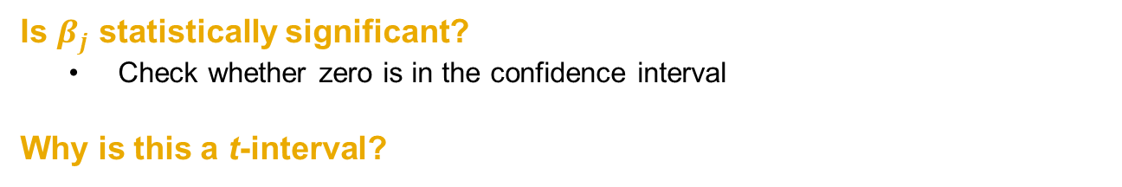
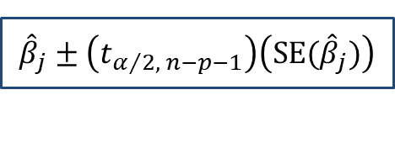
Confidence Interval Estimation
We can derive confidence intervals for $β_{j}$using this t sampling distribution:
$${\hat{β}}_{j}±\left(t_{α/2, n−p−1}\right)\left(SE({\hat{β}}_{j})\right)$$
Is $β_{j}$ statistically significant?
  Check whether zero is in the confidence interval
Why is this a t-interval?

Slide 6


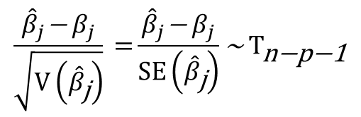


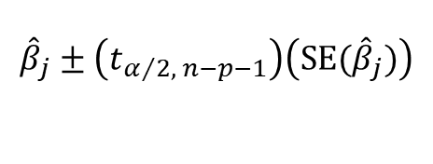
Confidence Interval Estimation
Why is this a t-interval?
$$\frac{{\hat{β}}_{j}\text{−}{ β}_{j}}{\sqrt{\text{V}\left({\hat{β}}_{\text{j}}\right)}} \text{=}\frac{{\hat{β}}_{j}\text{−}{ β}_{j}}{SE\left({\hat{β}}_{\text{j}}\right)}\text{\sim } {\text{T}}_{\text{n}\text{−}\text{p}\text{−1}}$$
t-interval for $β_{j}$
$${\hat{β}}_{j}±\left(t_{α/2, n−p−1}\right)\left(SE({\hat{β}}_{j})\right)$$
1-α Confidence Interval for $β_{j}$
Estimate
of${ β}_{j}$
t-critical
point
Standard Deviation/Error of ${\hat{β}}_{j}$

Slide 7




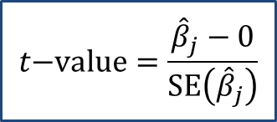
Testing Statistical Significance
To test for statistical significance of $β_{j}$ given all other predicting variables in the model, use a t-test for $H_{0}$ and $H_{a}$:
$$H_{0}: β_{j}=0$$
vs.
$$H_{a}: β_{j}≠0$$
$$t\text{−}value=\frac{{\hat{β}}_{j}−0}{SE\left({\hat{β}}_{j}\right)}$$
Reject $H_{0}$ if |t-value| gets too large
Interpret rejecting the null hypothesis as $β_{j}$ being statistically significant

Slide 8
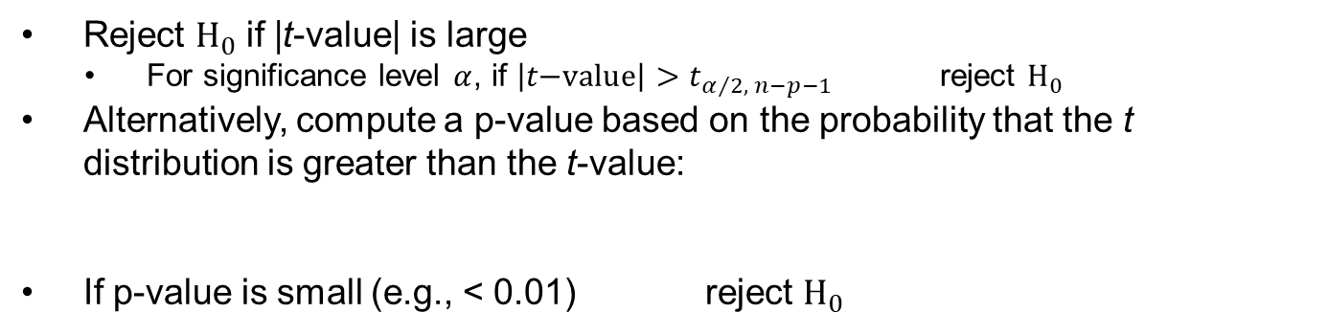



Testing Statistical Significance
$$H_{0}: β_{j}=b$$
How will the procedure change if
we test
vs.
for some known b?
$$H_{a}: β_{j}≠b$$
$$t\text{−}value=\frac{{\hat{β}}_{j}−b}{SE\left({\hat{β}}_{j}\right)}$$
Reject $H_{0}$ if |t-value| is large
  For significance level $α$, if ${\left|t\text{−}value\right|>t}_{α/2, n−p−1}$ reject $H_{0}$
  Alternatively, compute a p-value based on the probability that the t distribution is greater than the t-value:
  If p-value is small (e.g., < 0.01) reject $H_{0}$
p-value = 2Prob(T_{n-p-1} > |t-value|)

Slide 9





Testing Statistical Significance
How will the procedure change if we test whether a coefficient is statistically positive or negative?
Test for Statistically Positive
Test for Statistically Negative
$$H_{0}: β_{j}≤0$$
$$H_{0}: β_{j}≥0$$
vs.
vs.
$$H_{a}: β_{j}>0$$
$$H_{a}: β_{j}<0$$
p-value = Prob(T_{n-p-1} > t -value)
p-value = Prob(T_{n-p-1} $<$t -value)

Slide 10

Summary

